Slide 1
LOCATION RECOMMENDATION FOR A NEW BUSINESS UNIT THE BATTLE OF NEIGHBORHOODS
DATA SCIENCE CAPSTONE PROJECT
PRESENTED BY
MD MEHEDI HASAN

Slide 2
Business Problem
Statement:
Identify a neighborhood in Toronto to open an ‘Indian Arts, Dance and Cultural Centre’ and with restaurants in the vicinity
Solution:
Find a neighborhood inhabited by people with Indian origin and with good number of restaurants

Slide 3
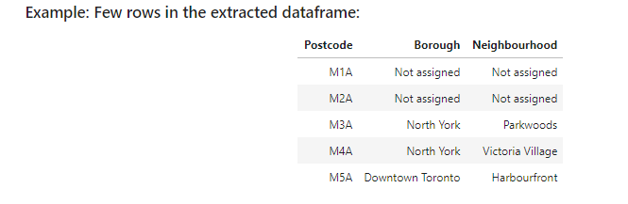
Data Section
Data Sources
Toronto neighborhoods: https://en.wikipedia.org/wiki/List_of_postal_codes_of_Canada:_M

Slide 4
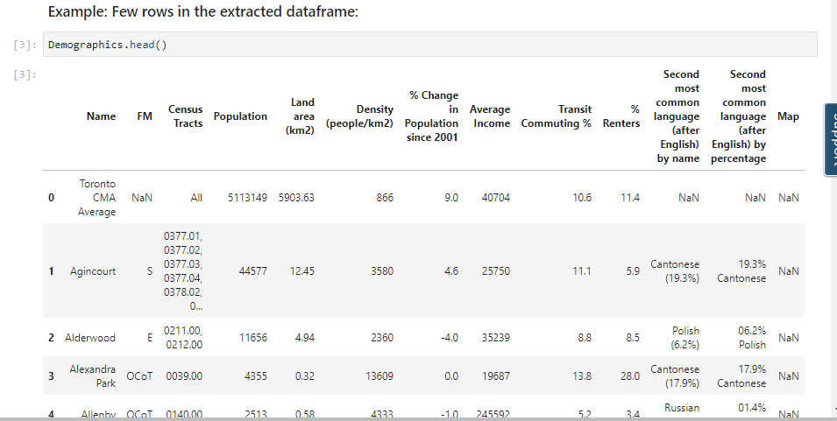
2. Demographics of Toronto neighborhoods: https://en.wikipedia.org/wiki/Demographics_of_Toronto_neighborhoods

Slide 5
3. Geocoder/Google geolocation API/Geo spatial coordinates csv file:
Finding the geospatial coordinates of a location - Geocoding
The following information was returned for the coordinates of ‘Downtown Toronto’
The geographical coordinates of Downtown Toronto are 43.6541737,
-79.3808116451341

Slide 6
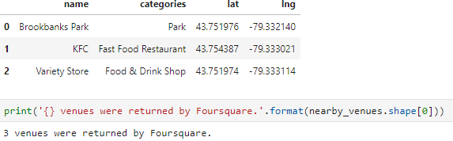
4. Foursquare API:
Foursquare - one of the most popular Location Based Social Network (LBSN) in recent times
Provides personalized recommendations of places to go to near a user's current location based on users' previous browsing history, purchases, or check-in history
Example: Venues returned by Foursquare for ‘Parkwoods’ neighborhood

Slide 7
Methodology
Merge the three dataframes related to Demographics of Toronto, Neighborhoods of Toronto, Geospatial coordinates for neighborhoods of Toronto
Use Foursquare credentials to get the top 100 venues in each neighborhood
222 unique categories were identified
Create a dataframe listing the top 10 venues for each neighborhood - data set for performing clustering at a later stage

Slide 8
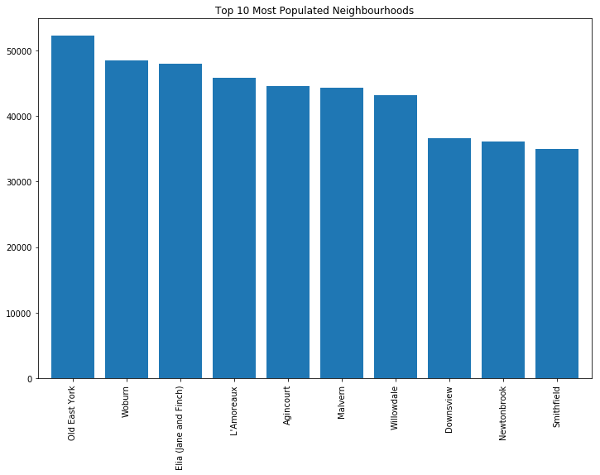
Exploratory Data Analysis
Top 10 most populated neighborhoods

Slide 9
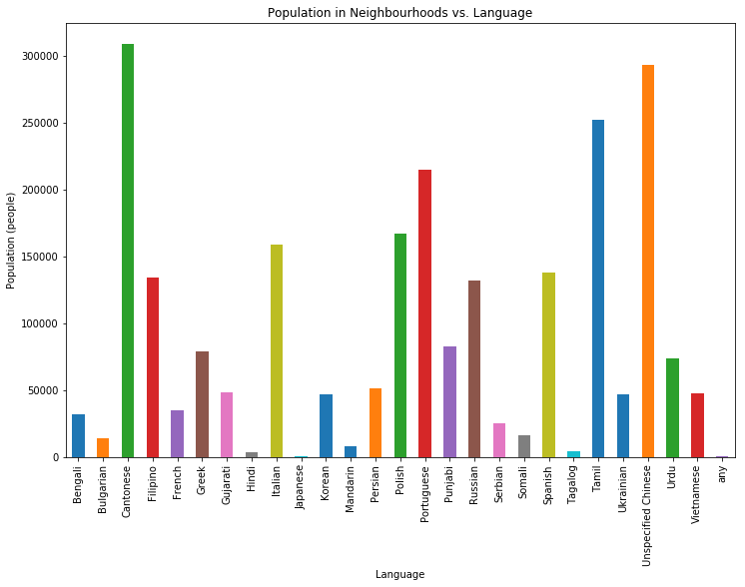
Neighborhood population versus the second most popular language (after English) in the neighborhood

Slide 10
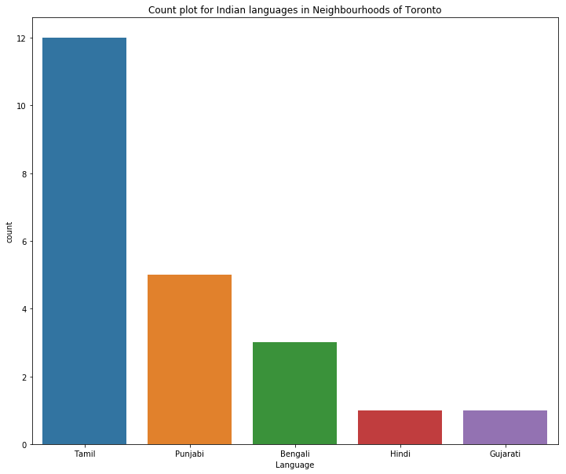
Indian languages in different neighborhoods of Toronto

Slide 11
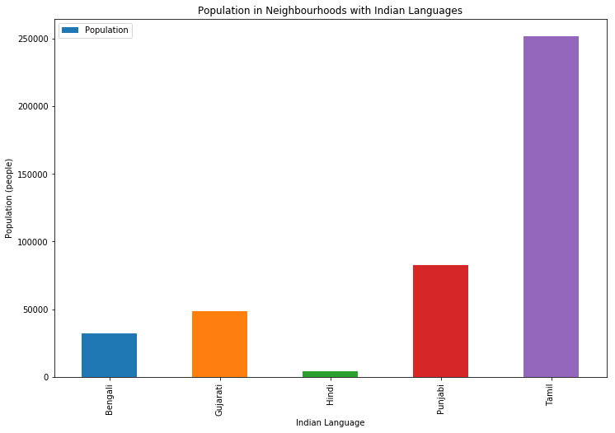
Population in neighborhoods with Indian languages

Slide 12
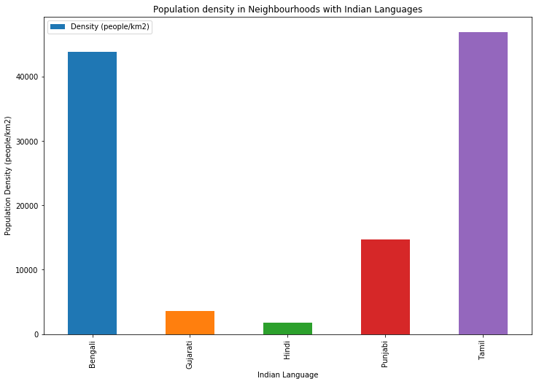
Population density in neighborhoods with Indian languages

Slide 13
Inference
Identify a neighborhood
where Tamil is the most popular language (after English) and
with good number of restaurants

Slide 14
Machine Learning Algorithm
Goal: Identify a suitable neighborhood among several neighborhoods
An unsupervised machine learning problem
Clustering techniques can be used
K means clustering
Simple and inexpensive
Efficient when working with large data sets

Slide 15
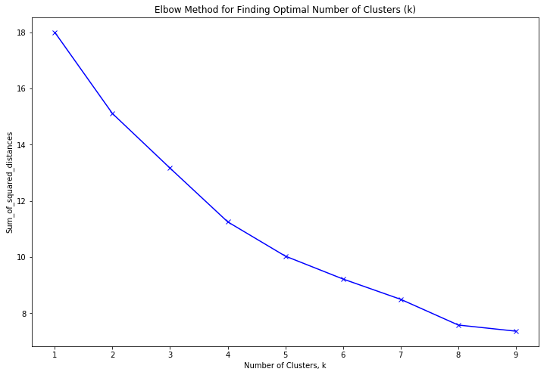
Elbow method:
find the optimum value for the number of clusters, ‘k’

Slide 16
Results
Each cluster was analysed to identify neighborhoods with Indian language and restaurants in the vicinity
Few neighborhoods meeting the language requirement were observed, but do not include many restaurants
The results show that 'Dorset Park' is the best choice
a neighborhood with Tamil language
includes relatively more number of restaurants

Slide 17
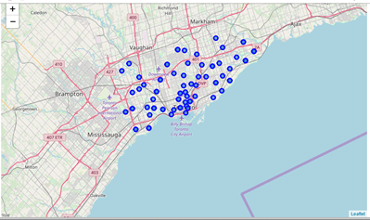
Neighborhoods of Toronto

Slide 18
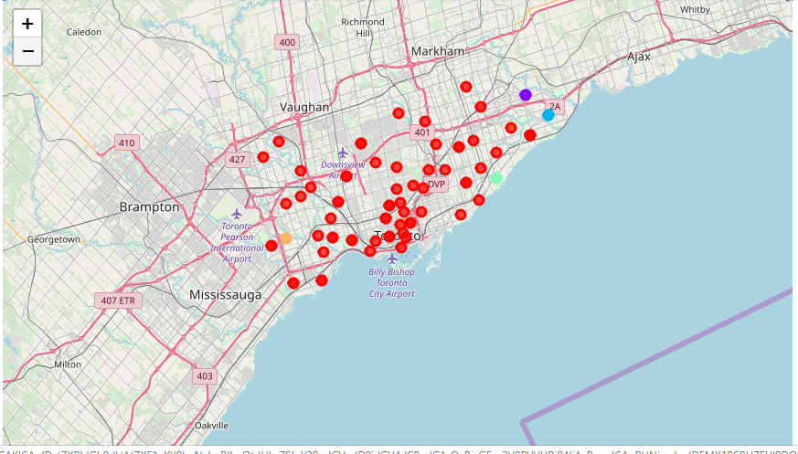
Clusters of Neighbourhoods (k = 5)

Slide 19
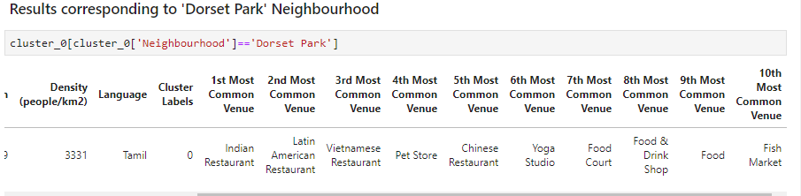
10 Most Common Venues in ‘Dorset Park’ Neighborhood

Slide 20
Discussion
Optimum k value is 5
First cluster
very dense
includes 67 neighborhoods
several restaurants, pizza points and coffee shops
Second cluster
2 identical neighborhoods
Third cluster
3 similar neighborhoods
Fourth and Fifth clusters
2 neighborhoods each

Slide 21
Conclusion
Data visualization - powerful in drawing insights from data and towards addressing the business problem at hand
Location Based Social Networks - provide the flexibility to solve several interesting problems
In this capstone project, exploratory data analysis and Foursquare API data were used to identify a neighborhood for opening an ‘Indian Arts, Dance and Cultural Centre’
Innovative business solutions can be obtained by performing similar analysis on many problems related to several fields

